Slide 1
Extending the SharePoint 2010 Search Infrastructure
Notes:
Microsoft invested considerably in search in SharePoint 2010 from the previous release. This module will explore the different capabilities of search in the SharePoint 2010 stack including SharePoint search and FAST Search. In addition you will learn how to customize and extend the search experience.

Slide 2
Agenda
Search Terminology
Search Architecture (SharePoint Search & FAST)
SharePoint 2010 Search & FAST Compared
.NET Assembly Connectors
Enhancing the Search User Interface
Creating Custom Ranking Models
Custom Search Development Solutions

Slide 3
SharePoint 2010 Search Product Line
Product
Key Themes
Capabilities of SharePoint Search 2010 PLUS:
Conversational user experience
Enhanced content processing capabilities
Deep platform flexibility and scale
FAST Search for SharePoint 2010
High End
Complete search experience
Unique social search features
Industrial strength capabilities
SharePoint platform integration
SharePoint Search 2010
Infrastructure
Search Server Express 2010
Basic search experience
Simple to set up and deploy
Great price!
Entry Level
Notes:
SharePoint Foundation 2010 Search is the search engine that ships with SharePoint Foundation. This search engine works only on a single site collection at a time and cannot index external data sources. This engine is intended for team or departmental installations of SharePoint that do not require Enterprise Search.
Search Server Express is an Enterprise Search product that is freely downloadable. This engine can index external sources and supports search federation. It is intended for organizations that want an Enterprise Search capability but do not require significant scalability.
Search Server 2010 is an Enterprise Search engine that can scale across multiple servers and tens of millions of items. This product is the upgraded version of Search Server Express. It is intended for organizations that need a scalable search engine but are not using SharePoint Server 2010. SharePoint Server 2010 includes all the capabilities of Search Server 2010, along with the integration of people search, taxonomy, and social networking. This is the Enterprise Search engine that is built into SharePoint Server, and it is the one that most readers will be using. Therefore, this chapter will focus on the overall search architecture and customizations that can be created by developers using SharePoint Server 2010.
FAST Search Server 2010 for SharePoint is the most powerful of all the search offerings. FAST provides scalability beyond any of the other offerings and supports additional customizations and configurations.

Slide 4
Agenda
Search Terminology
SharePoint 2010 Search Architecture
SharePoint 2010 Search & FAST Compared
.NET Assembly Connectors
Enhancing the Search User Interface
Creating Custom Ranking Models
Custom Search Development Solutions

Slide 5
Search Components & Terminology
Content Source: Content to be indexed
Examples: SharePoint site, external sites, file share, Notes, external data
Protocol Handler: Enables SharePoint to connect to consent sources
iFilter: Used to extract content from source
Word Breaker*: Breaks appropriate words up
Example: [heart attack] is not two words “heart” “attack”, it means one thing
Word Stemmer*: Normalizes words
Examples: mice & mouse, child & children
Noise Eliminator: Removes noise from index
Examples: and, the, of, when
Search Scope: Named search configuration including content sources & rules of content to include / exclude in results
Examples: Intranet Content, Company Employees, Competition Sites
* based on the Language Pack(s) installed

Slide 6
Agenda
Search Terminology
Search Architecture (SharePoint Search & FAST)
SharePoint 2010 Search & FAST Compared
.NET Assembly Connectors
Enhancing the Search User Interface
Creating Custom Ranking Models
Custom Search Development Solutions

Slide 7
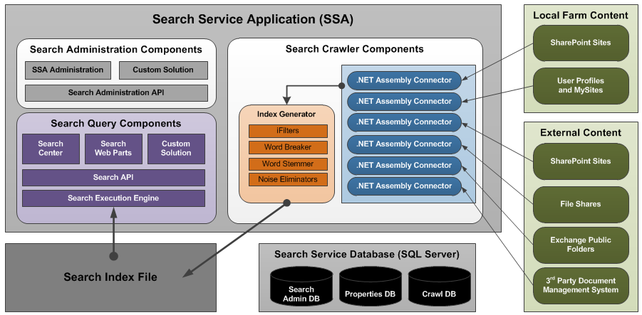
SharePoint Server 2010 Search Architecture
Notes:
Search Index Process
The indexing process is responsible for building the index file. The index file contains proper-ties from content sources, along with access control information that ensures search results display only content for which the user has rights. The process of building the index file involves crawling the designated content sources.
A content source is a repository that you want to search. Content sources can be SharePoint sites, websites, external file systems, Exchange Server public folders, Business Connectivity Services (BCS) External Systems, or other custom repositories. The Index Engine gains access to these repositories through .NET Assembly Connectors and access to the contents of individual items through IFilters.
The indexing process uses .NET Assembly Connectors to connect with content sources. In previous versions of SharePoint, Protocol Handlers were the primary means of connecting with content sources, but they were difficult to create in managed code. In SharePoint 2010, Protocol Handlers are still supported, but .NET Assembly Connectors should be created whenever a custom repository is used as a content source.
Just as in previous versions of SharePoint, IFilters are used to allow the indexing process to access the contents of an item. For example, IFilters allow the indexing process to access the body of Microsoft Office documents so that a full-text search can be performed. While SharePoint 2010 ships with IFilters for Office documents, you may need to install additional IFilters for other types, such as Portable Document Format (PDF) documents. Generally, IFilters are available from the appropriate manufacturer, such as Adobe, and require a simple installation on the server where the indexing process runs.
Search Query Process
Once the index file is created, it may be used to support query execution. Query execution begins when a user navigates to the Search Center and enters a query. The query in the Search Center may take the form of a simple keyword or an advanced search with multiple values against multiple Managed Properties.
When the user issues a search, the query is sent to the search engine. Within the search engine, the query processor accepts the query and also retrieves any required information from the Managed Properties database. Information from the Managed Properties database is required any time a query is issued against a specific Managed Property, such as Title. The combination of the user query and Managed Property information is then sent to the query server, which executes the query and returns the results. The results are returned as Extensible Markup Language (XML) to the Search Center where they are formatted using Extensible Stylesheet Language for Transformations (XSLT).
Along with performing a query on its own index, SharePoint can send the query out to other federated search locations. Federated search locations are connections to other search services that independently run the query and return the results separately to the Search Center for display. Communication with federated locations is based on the Open Search protocol, so any search service that supports Open Search can be used as a federated location.

Slide 8
FAST Search Server 2010 for SharePoint
Advanced & Configurable Content Indexing
Configurable Pipeline
Auto property extraction: people, location & company
Extend for additional property extractors
Advanced & Configurable Query Processing
Pipeline
Ideal for massive content corpus
SharePoint Server 2010 scales to 100M documents
Notes:
FAST Search Server 2010 for SharePoint effectively replaces SharePoint Server 2010 search and is suited to customers who are looking to build very robust search experiences for end users with a significant amount of configuration (some automatic, some manual) and the ability to scale to a seemingly open-ended limit. For instance SharePoint Server 2010 search tops out around 100,000,000 documents in a deployment whereas FAST Search Server 2010 for SharePoint can scale out to support many times that limit. FAST is a much more expensive and requires additional licenses and servers to deploy.
From an architectural perspective there are two very big differences between SharePoint Server 2010 and FAST Search Server 2010 for SharePoint: indexing content & processing queries. Both sides have a configurable pipeline that administrators can configure using some of the default content & query processors but can also create their own processors to snap in and add additional processing as the content is indexed. FAST also uses a different index file format that is optimized for a much larger corpus that is traditionally involved in SharePoint Server 2010 search deployments.
Content Pipeline Stages
Default
Format Conversion - iFilters, OutSideIn
Language and encoding detection
Lemmatizer - Linguistics normalization
Tokenizer - Word breaking
Entity Extraction - Companies, locations
DateTimeNormalizer - Date normalization
Vectorizer - Create document vector for similarity searching
WebAnalyzer - Anchor text and link cardinality analysis
PropertiesMapper - Map to crawled properties
PropertiesReporter - Report detected properties
Optional
XML Properties mapper
Offensive Content Filter
Verbatim (wholeword) extractor
Loads dictionary for custom extraction, e.g product names
Field Collapsing
Entity Extraction
Persons

Slide 9
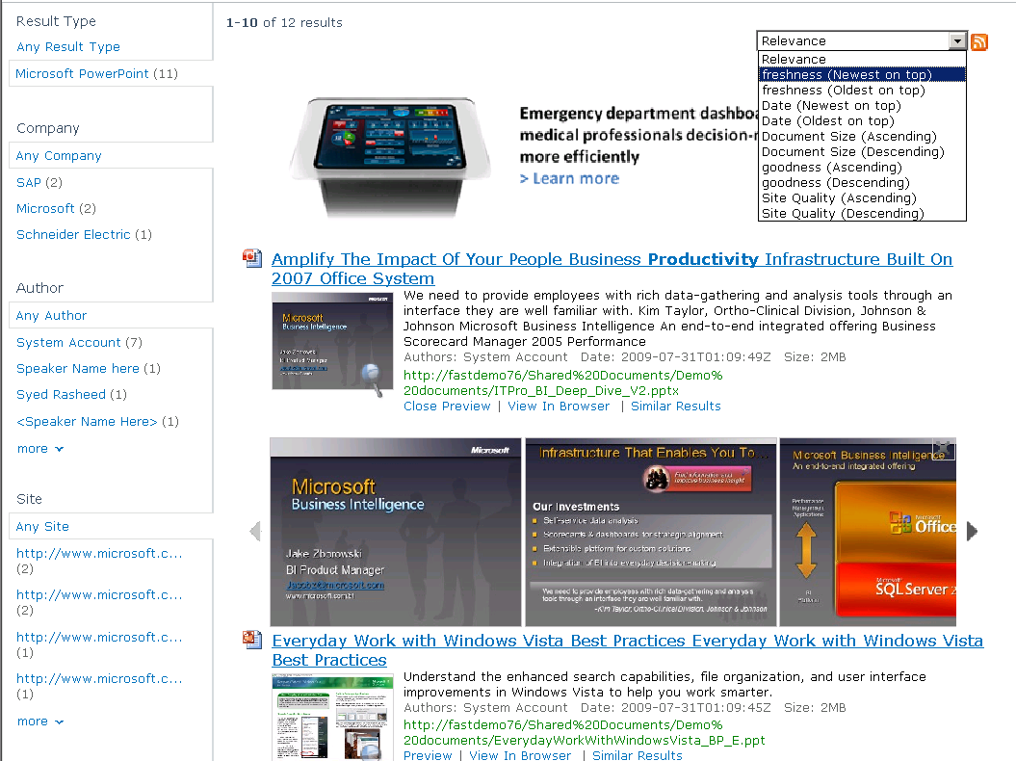
FAST Search Server Example
Sorting on any property
Visual Best Bets
Scrolling PowerPoint
Previews
Refinement with counts
on any property
Thumbnails
Similarity Search
Notes:
This slide demonstrates how FAST Search Server for SharePoint 2010 allows you to go beyond the out-of-the-box SharePoint Server 2010 search capabilities, what’s referred to as “go beyond the search box” and create visual and conversational search solutions.

Slide 10
Agenda
Search Terminology
Search Architecture (SharePoint Search & FAST)
SharePoint 2010 Search & FAST Compared
.NET Assembly Connectors
Enhancing the Search User Interface
Creating Custom Ranking Models
Custom Search Development Solutions

Slide 11
SharePoint Server 2010 vs. FAST Search Server End User Perspective
SharePoint Server 2010
Excellent OOB relevance
Federated results
Metadata based refiners
Query Suggestions
Did You Mean
Related Searches
View in browser
People search
Phonetic & nickname matching
Social behavior improves relevance
FAST Search Server
Thumbnails & Previews
Visual Best Bets
Deep refiners with counts
User context from user profile
Multiple relevance profiles
Sorting on any property
Similarity Search
Broader, better language support
Richer query language

Slide 12
SharePoint Server 2010 vs. FAST Search Server IT Professional Perspective
SharePoint Server 2010
Enterprise Scale-out (to 100M docs)
Full Fault Tolerance
Native x64; Hyper-V support
Wizard - driven installation
Consolidated search dashboard
PowerShell support
SCOM support
Full search reporting
Full set of connectors OOB
Easy to add new sources via .NET Assembly Connectors
FAST Search Server
Extreme scale-out
Content Processing pipeline
Entity extraction
Tunable relevance ranking
Easy setup of User Context, Visual Best Bets, Promotion/ Demotion
Easy to configure sorting, and refinement

Slide 13
SharePoint Server 2010 vs. FAST Search Server Developer Perspective
SharePoint Server 2010
Public Web Parts
.NET Connector Framework
Integrated with Business Connectivity Services (BCS)
Integrate search with business intelligence, workflow, social, & collaboration
BDC tooling built into SharePoint Designer
Application tooling in VS2010
FAST Search Server
Public Web Parts with high end capabilities
Add custom property extractors
Extend content processing
Include external data into relevance
Build multiple relevance profiles
Extend user context
Use advanced query capabilities to create powerful applications

Slide 14
Agenda
Search Terminology
Search Architecture (SharePoint Search & FAST)
SharePoint 2010 Search & FAST Compared
.NET Assembly Connectors
Enhancing the Search User Interface
Creating Custom Ranking Models
Custom Search Development Solutions

Slide 15
Connector Framework
Office SharePoint Server 2007 Indexing
Protocol Handlers
Business Data Catalog IDEnumerators
SharePoint Server 2010 Connectors
Exchange
Notes
Documentum
File Net
Open Text
Custom .NET Connector
Notes:
MOSS 2007 Indexing
The first method called “Protocol Handler” method has existed for nearly a decade (present since old ages of Site Server following into SPS2003) and provided an unmanaged COM interface that 3rd party 2010 partners/developers could write custom code into. This interface was directly plugged into the search indexer making it a highly performant way to index data from custom repositories. Also, the model was low level enough that any type of custom repository could be expressed to the Search System. This method is known for its complexity which made it unusable by many customers. The SharePoint 2010 Search Team decided to dramatically simply what is offered to customers.
The second method got introduced as recent as SharePoint 2007. Search took advantage of a new product in SharePoint 2007 called “Business Data Catalog” (BDC) as it specialized in interacting with data in complex external data repositories. Search made use of BDC to index data from databases and Web services backed repositories. There was a significant payoff as the new technology enabled crawls of back-end systems by just expressing connections to repositories declaratively (XML) without having to write any code. The Search still leverages BDC as a way to connect to external data since that’s the strategy prescribed in Office Team as BDC becomes front and center for interacting w/ business repositories.
SharePoint 2010 introduces a new model using the .NET Connectors and .NET Assembly Connectors. Protocol handlers are still supported, but .NET Assembly Connectors are recommended as the new way of connecting to external systems.

Slide 16
.NET Assembly Connector
Specific capabilities that can be implemented in a .NET Assembly Connector that are useful in search scenarios
Support for attachments
Item-level security
Crawl across entity associations
Control the resulting display URL
Notes:
.NET Assembly Connectors enable the ability to fine tune what is possible in fine tuning specific capabilities for content when it is indexed as well as when it is queried and returned in search results:
Support for attachments:By default the search indexer can not examine documents in external data systems defined in external content types, however developers can implement this capability with .NET Assembly Connectors in that they can return a document back when the content is indexed. Assuming the index server has the necessary iFilters installed, it can index the content within the document.
Item-level security:External content types created with SharePoint Designer 2010 do not support item-level security as content indexed within SharePoint sites can. However using a .NET Assembly Connector developers can return an ACL by implementing a method on the .NET Assembly Connector called a BinarySecrurityDescriptor that returns a byte array.
Crawl across entity associations: .NET Assembly Connectors can also automatically crawl child items such as in an 1:MANY relationship like a ORDER:LINE ITEM when the content is indexed.
Control the resulting display URL: Finally, using a .NET Assembly Connector developers can also configure the profile page of the external content type to specify the ASPX page to take the user to when they click the item in the search results. This ASPX page can contain BCS Web Parts that display data coming from the external data system.

Slide 17
Search Enabling .NET Assembly Connectors
.NET Assembly Connectors need a little extra work to make them search friendly
Designate the specific Finder method to use as the RootFinder by adding it as a custom string property to the ECT
Configure to show in search by applying the ShowInSearchUI property to the model
Add to the LobSystemInstances in the model
Notes:
To search-enable an existing model, you must make two changes. The first change is to designate which method to call during the indexing process. The second change allows the model to appear as a content source in search. Both changes are simple edits to the XML.
.NET Assembly Connectors contain Finder methods that are defined as methods that return many records from an external system. Essentially, a Finder method defines a view of an external system. When search crawls an external system, it needs to know which of the available Finder methods represents the entire population of records to index. This finder method is known as the RootFinder method.
In your .NET Assembly Connector, you designate the RootFinder by first selecting the method instance in the Method Details pane. When you select it, the Properties window in Visual Studio 2010 will show details for the method. From this window, you can open the Custom Properties collection. In the Property Editor window, you can enter the RootFinder designation with a Type of System.String and a Value of x.
Once RootFinder is defined, you must make a change to allow the .NET Assembly Connector to appear as a content source in search. This is accomplished by applying the ShowInSearchUI property to the model. This property is applied by selecting the LobSystemInstance for your project under the LobSystemInstances folder in the model explorer. You may then create the property, again setting its value to x, using the same technique as for RootFinder.

Slide 18
DEMO
Creating a Search Center Site

Slide 19
Agenda
Search Terminology
Search Architecture (SharePoint Search & FAST)
SharePoint 2010 Search & FAST Compared
.NET Assembly Connectors
Enhancing the Search User Interface
Creating Custom Ranking Models
Custom Search Development Solutions

Slide 20
Search Web Parts
Advanced Search Box: Allows users to create detailed searches against Managed Properties
Federated Results: Displays results from a federated search location
People Refinement Panel: Presents facets that can be used to refine a people search
People Search Box: Allows users to search for people using a keyword
People Search Core Results: Displays the primary result set from a people search
Refinement Panel: Presents facets that can be used to refine a search
Related Queries: Presents queries related to the user’s query
Search Action Links: Displays links for Really Simple Syndication (RSS), alerts, and Windows Explorer
Search Best Bets: Presents best-bets results
Search Box: Allows users to enter keyword query searches
Search Core Results: Displays the primary result set from a query
Search Paging: Allows a user to page through search results
Search Statistics: Presents statistics such as the time taken to execute the query
Search Summary: Provides a summary display of the executed query
Top Federated Results: Displays top results from a federated location
Notes:
The SharePoint Server 2010 search experience is primarily implemented as a results page that contains a query string which is used to trigger the search query. Microsoft provides multiple Web Parts that can be placed on this results page to create a customized search experience.
Users make their way to the results page typically by going to another page that contains one of the search box Web Parts (Search Box, Advanced Search Box or People Search Box).

Slide 21
Customizing Search User Interface
Extend OOTB Web Parts
Extend any Web Part to change default behavior
Previous SharePoint versions used sealed Web Parts
Add new Web Part that interacts with existing Web Parts on the search page
Web Parts communicate through the QueryManager
QueryManager coordinates execution of query & returns results as XML
Notes:
Significant improvements on extending the Search UI over SharePoint 2007:
OOTB Search Web Parts – All are now public and can be subclassed (not possible in SharePoint 2007).
All search Web Parts can now talk though a central shared public interface (SharedQueryManager) to create custom search Web Parts.

Slide 22
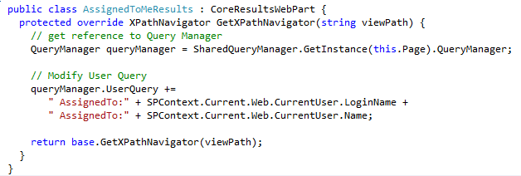
Customizing Search Query
Ability to modify query before it leaves the end user page
Override the GetXPathNavigator() method of Search Core Results Web Part
Notes:
One customization developers can do BEFORE the query is run is to tap into the query and augment it with additional information. For instance the code snippet in the slide creates a custom Search Core Results Web Part object called AssignedToMeResults which automatically adds to the query a filter that looks for content assigned to the current user executing the query.

Slide 23
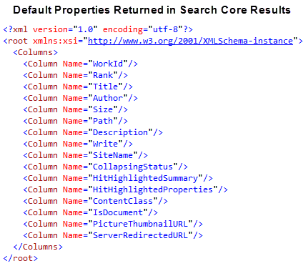
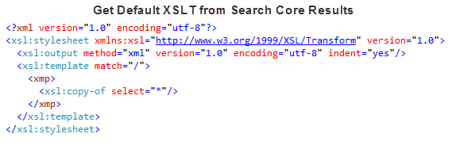
Customizing Search Results
Ability to modify the search results before the results are displayed to the users
Developers can customize the XSLT used by the Search Core Results Web Part
Notes:
Developers can also customize the rendering of the results in the Core Results Web Part. The columns that appear in the search results are specified by the Fetched Properties property, located under the Display Properties category of the Search Core Results Web Part. This property contains an XML chunk that defines which properties should appear in the search results.
You can customize the Fetched Properties XML to return different columns. Simply add or remove Column elements from the XML. Note that the column Name must refer to an existing Managed Property. In addition, adding the column to the Fetched Properties XML will not actually cause the column to be displayed in the search results. For this to happen, you must also modify the XSLT used to render the search results. Search results are returned to the Search Core Results Web Part as XML. This XML is transformed into the display seen in the Search Center by applying the XSLT contained under the Display Properties of the Search Core Results Web Part properties. While you have complete access to this XSLT and can customize it significantly, SharePoint provides no graphical environment for understanding how changes to the XSLT will affect the display of the search results. Fortunately, we can use a combination of SharePoint Designer 2010 (SPD) and Microsoft Visual Studio to create and analyze the XSLT.
To begin modifying the XSLT, you must first get a copy of the raw XML sent to the Search Core Results Web Part prior to transformation. The simplest way to do this is to replace the XSLT with a null transformation. Doing so will cause the search results to appear as XML. Be sure that you have created all required Metadata Properties and updated the Fetched Columns before generating the raw XML. After you have a copy of the raw XML generated by the search, you can use it as a basis for creating the desired XSLT. The simplest way to create XSLT is by using SPD. This is because the Data View Web Part accepts an XML file as a data source and will generate XSLT as you use SPD to customize the display.
Start by opening SPD to any site. You will not be keeping any of the pages you create for this exercise, so the exact location of the pages is irrelevant. Once inside SPD, click on the Data Sources object, and then select to add a new XML File Connection from the New group on the Ribbon. Add the raw XML file that you generated from the search results.Next, add a Web Part page to the site and place it in edit mode. From the edit menu, insert a Data View Web Part based on the raw XML file. Once the Data View Web Part is on the page, you can use the Add/Remove Columns dialog to decide what columns to display. In addition, you can go directly to the source view to make edits to the generated XSLT, which is contained between the XSL tags in the document. Once you have the search results appearing as you want them, simply copy the XSLT out of SPD and into the Search Core Results Web Part.

Slide 24
DEMO
Customizing the Search Core Results Web Part

Slide 25
Agenda
Search Terminology
Search Architecture (SharePoint Search & FAST)
SharePoint 2010 Search & FAST Compared
.NET Assembly Connectors
Enhancing the Search User Interface
Creating Custom Ranking Models
Custom Search Development Solutions

Slide 26
Ranking Models
Admins use XML files to describe new Ranking Models
Custom ranking models rank using a weighted-average of the features in the XML descriptor
BM25F (Query Dependent Feature)
Static features
Click Features (static)
Manage Ranking Models using PowerShell
Use Custom Ranking Model in End user using Web Part Property
Multiple OOB Ranking Models
Different for Core Results and People
Cannot be modified
Notes:
SharePoint 2010 search contains the following default ranking models:
Default ranking model
Two-layer neural net model
Possibly several other ranking models for people search and “Sort by Date” etc.
It isn’t possible to customize these OOTB models directly. Instead a template ranking model that can be edited in order to create new models. The following relevance features will only be supported in the default models:
Distance
Minspan
Document length.
These are not included in the ranking model schema that will be published as part of the Relevance OM documentation on MSDN. There are 2 options for creating ranking models:
Starting with the “default” list of static and dynamic ingredients in the linear model by getting the template XML model and then editing and uploading the modified ranking model XML file.
Creating a new model in XML which conforms to SharePoint’s ranking model schema.
Custom ranking models are not versioned. Any updates/changes to a model override the existing model. Creating a new model based on the “default” and customizing it will satisfy requirements for changing weights on OOTB relevance features, similar to the SharePoint 2007 support for altering weights on managed 2010 properties.
However, admins will need to do the extra step of associating the model to the search results Web Parts on Web sites where they want the new ranking model. Creation of a new XML model based on the schema will satisfy the requirement for specialized search applications to create a unique model targeted to their business requirements. Each new release of SharePoint may contain a new version of the ranking model schema may be created.
In order to maintain compatibility of custom ranking models created using previous versions of the ranking model schema, the version number of the schema will be indicated using the schema version attribute.
New versions of the schema will retain all previous elements and attributes, although new elements and attributes may be added.

Slide 27
DEMO
Custom Ranking Model

Slide 28
Agenda
Search Terminology
Search Architecture (SharePoint Search & FAST)
SharePoint 2010 Search & FAST Compared
.NET Assembly Connectors
Enhancing the Search User Interface
Creating Custom Ranking Models
Custom Search Development Solutions

Slide 29
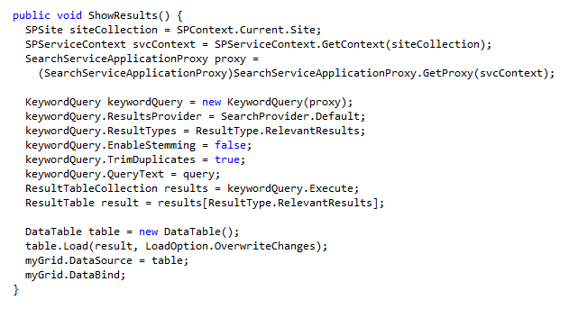
Keyword Search Syntax
SharePoint search supports keyword queries:
business - "Business Connectivity Services" -"Business Intelligence"
"Business Connectivity Services" OR "Business Intelligence“
Custom solutions can also use the keyword query syntax via the KeywordQuery class
Notes:
Keyword query syntax allows users to enter keywords, phrases, and Managed Property names to create sophisticated searches. In addition, keyword query syntax supports operations and wildcards.
The simplest form of keyword query is to enter a single term, without spaces or punctuation (for example, Training). This form will cause SharePoint to search both the index and the Metadata Properties, returning all matching results. A more sophisticated search would involve multiple keywords, but these must be enclosed in quotations (for example, “Training Materials”). Required and excluded terms may be added to the query using plus (+) and minus (-) signs.
In the first example the query returns results for the term “business” except when it is used in the phrase “Business Connectivity Services” or “Business Intelligence.” Operators may also be used with keywords. This includes Boolean operators, wildcards, and arithmetic. Boolean operations are done using the AND and OR operators. Wildcards are supported via an asterisk (*). This is demonstrated in the second example.
Along with using keyword query syntax in Search Center, developers may also create custom search Web Parts based on keyword queries. The KeywordQuery class contains the functionality necessary to issue keyword queries programmatically. The KeywordQuery class contains several properties for preparing the query and an Execute method to run the query. The query results are returned as a ResultTableCollection, which contains a collection of IDataReader objects.
To use the KeywordQuery class, you must create an instance that references the search service application proxy. Once the class is created, then you can set the QueryText property with keyword query syntax. Additional properties, such as TrimDuplicates and EnableStemming, allow finer control over the query. When the results are returned, you may process them manually or bind them directly to a control.

Slide 30
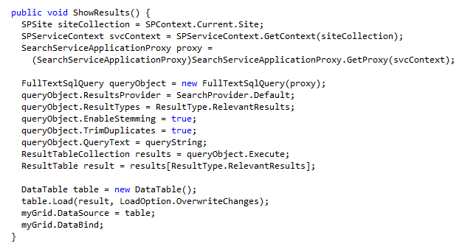
SQL Full-Text Search
Enterprise SQL Search Query syntax
Full query language
Provides full control over the executed query
Use Enterprise SQL Search Query syntax with the FullTextSqlQuery class
Notes:
Enterprise SQL Search Query syntax is a full query language that gives you significant control over the executed query. The following code shows a query that returns the documents that were added to the SharePoint portal within the past week.
SELECT url, title, author
FROM Scope
WHERE "scope" = 'All Sites'
AND isDocument=1 AND write >DATEADD(Day,-7,GetGMTDate)
You can see that the Enterprise SQL Search Query syntax is straightforward. The SELECT part is used to designate the columns to return from the query. The FROM part always contains the Scope statement, refined by the WHERE part, which specifies the exact scope to search. The WHERE part also contains the filters to apply. The WHERE part supports arithmetic operators, Boolean operators, and more specific full-text predicates, such as FREETEXT and CONTAINS. FREETEXT matches the meanings of phrases against fields, while CONTAINS does a straight match against the text in a field.
The FullTextSqlQuery class is used to create and issue queries based on the Enterprise SQL Search Query syntax. Using the FullTextQuery class is similar to using the KeywordQuery class. The query is set in the QueryText property, and additional properties are available to refine the search. Like the KeywordQuery class, the FullTextQuery class returns results as a ResultTableCollection.

Slide 31
Summary
Search Terminology
Search Architecture (SharePoint Search & FAST)
SharePoint 2010 Search & FAST Compared
.NET Assembly Connectors
Enhancing the Search User Interface
Creating Custom Ranking Models
Custom Search Development Solutions

